Slide 1
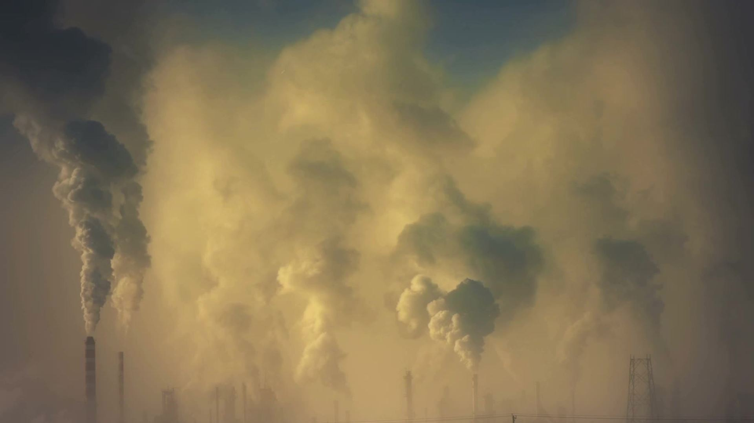
The Bhopal Gas Tragedy
By Karthik Pai

Slide 2
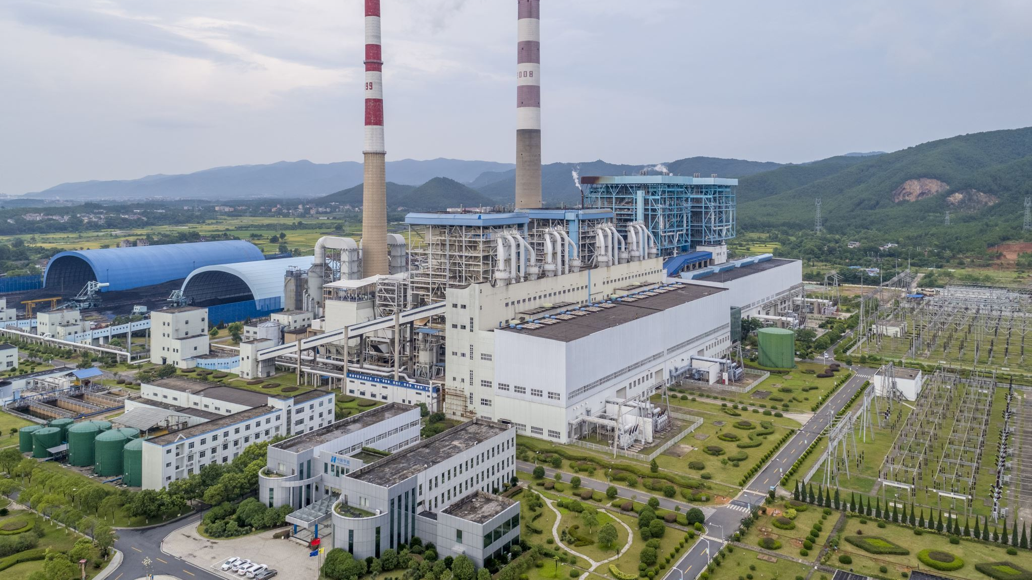
Introduction
Occurred on December 2-3, 1984, in the city of Bhopal, India
Pesticide plant owned by Union Carbide India Limited (UCIL) released toxic gas methyl isocyanate (MIC) into the air
Resulted in widespread panic and chaos

Slide 3
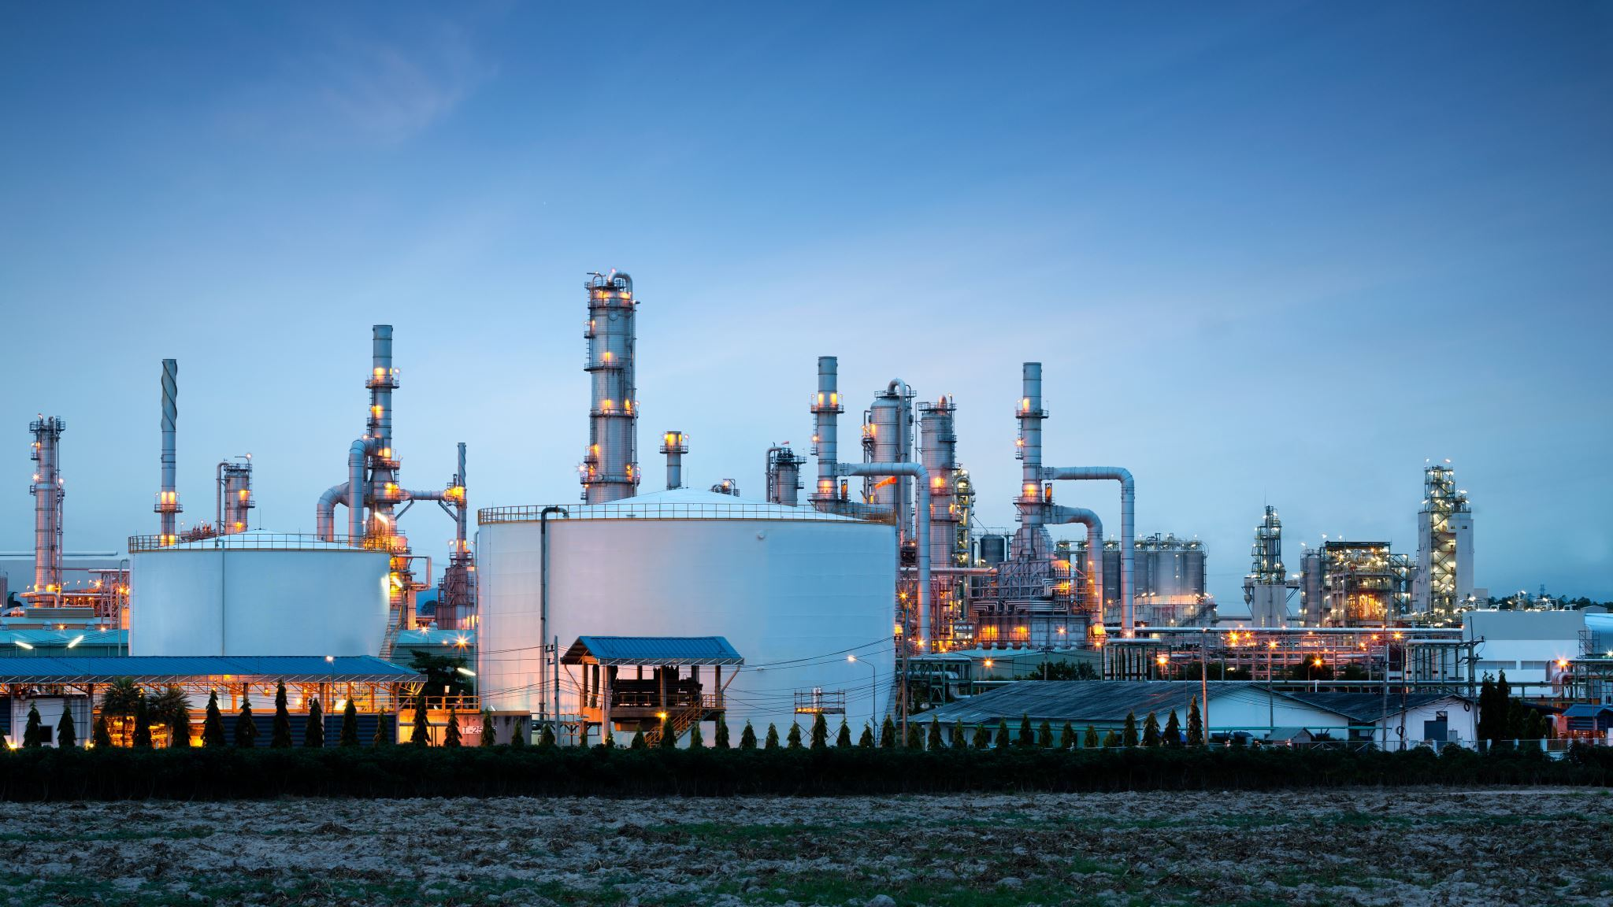
Background
UCIL plant produced pesticides using chemicals, including MIC
Concerns about the safety of the plant and its workers
Plant had undergone several expansions leading to safety concerns

Slide 4
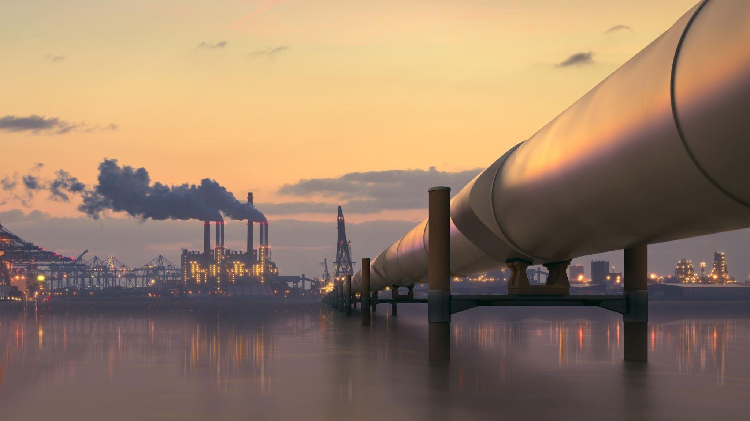
The Tragedy
Water entered a storage tank containing MIC causing a buildup of pressure
The tank ruptured releasing a cloud of toxic gas into the air
Gas spread over the city, affecting thousands of people

Slide 5

Immediate Response
Local authorities and emergency services were unprepared for the disaster
Plant management was slow to respond
Lack of information about the extent of the damage
Over 500,000 people exposed to the gas, death toll reached over 3,000

Slide 6
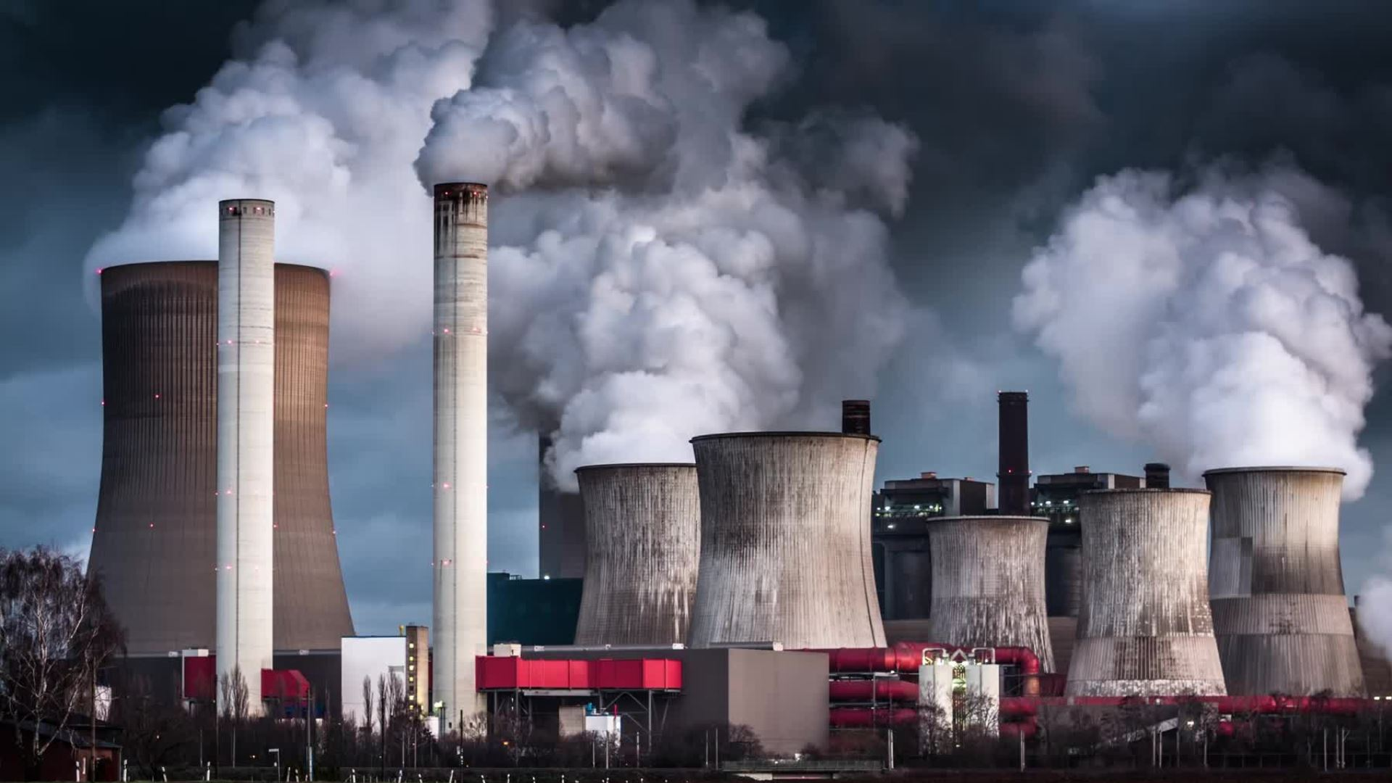
Long-Term Consequences
Many survivors suffered from chronic health problems
Effects of toxic gas still being felt today
Environment was affected by the disaster, causing contamination of the soil and water

Slide 7

Legal and Political Fallout
Union Carbide held responsible for the disaster
Paid a settlement of $470 million to the Indian government in 1989
Settlement was criticized as insufficient and justice not being served
Indian government also criticized for handling of disaster and its aftermath

Slide 8

Lessons Learned
Need for better safety regulations in chemical industry
Importance of disaster preparedness
Need for accountability
Improvements made in the way chemicals are stored and handled, and emergency response protocols

Slide 9
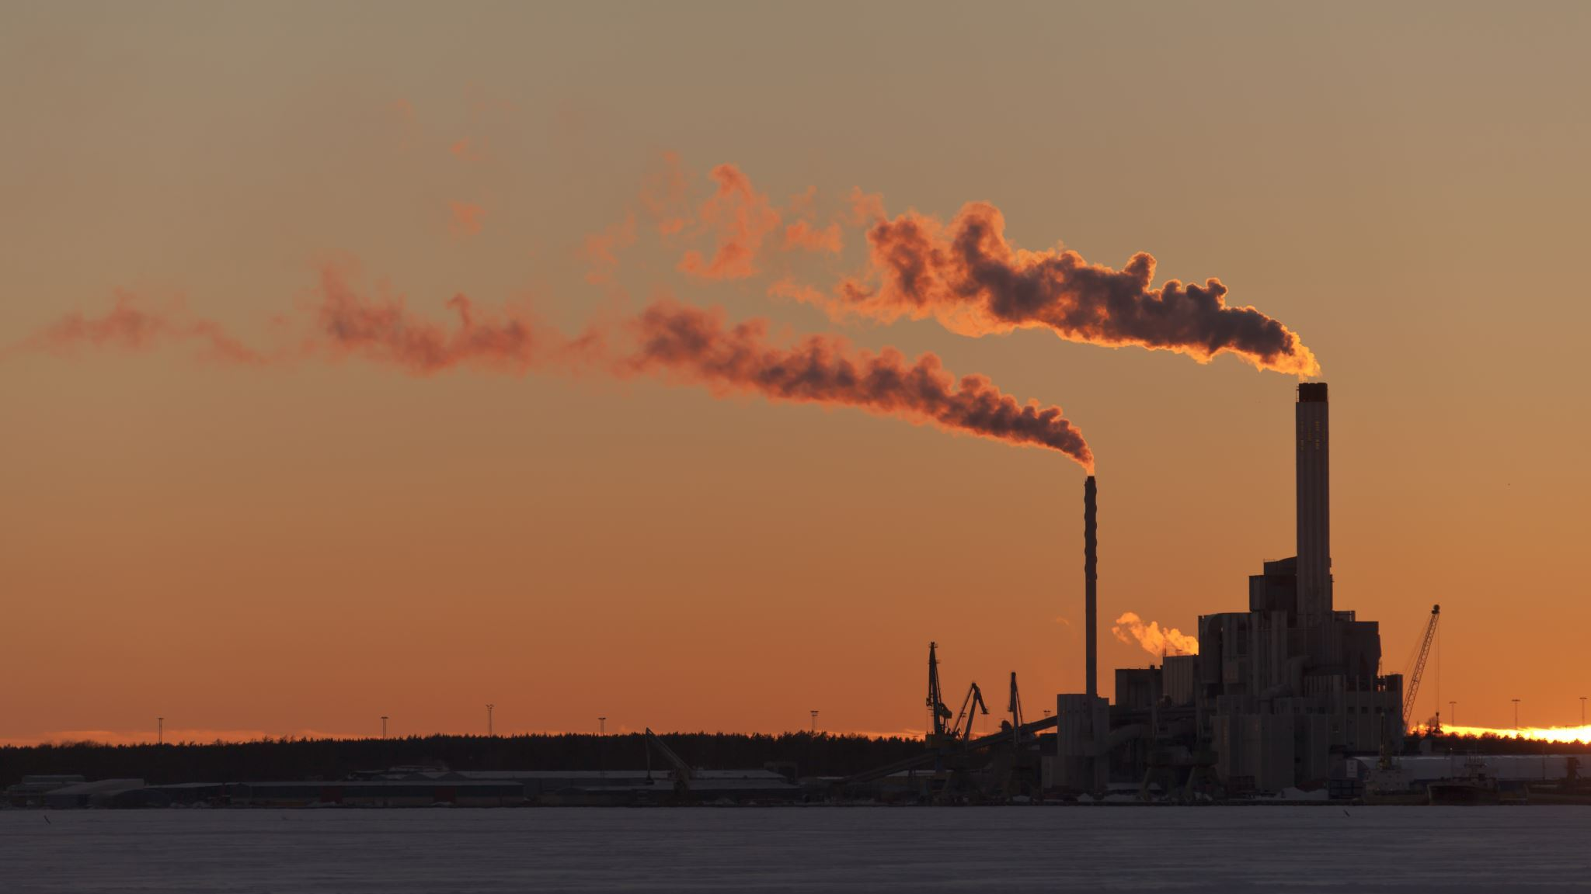
Conclusion
Bhopal Gas Tragedy was a devastating event with far-reaching consequences
Reminder of importance of safety, preparedness, and accountability
Increased awareness about impact of industrial pollution on public health and environment

